Slide 1

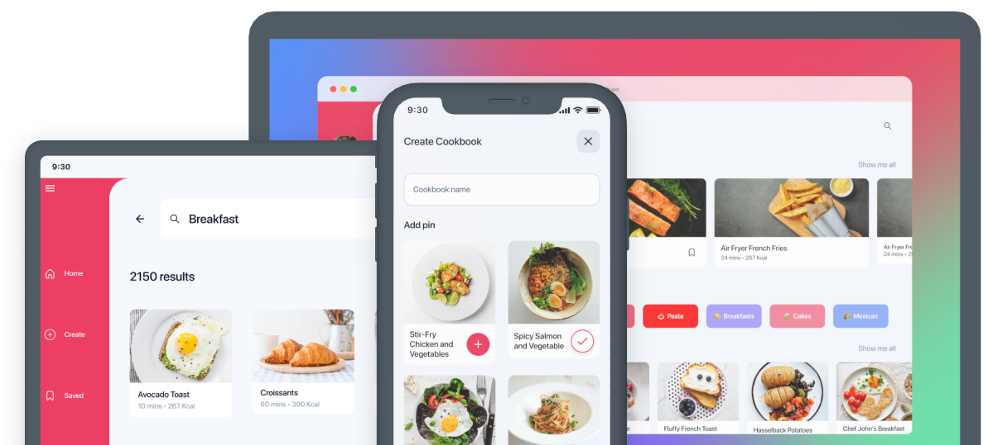
.NET Apps Everywhere!
Steve Bilogan

Slide 2








.NET

Slide 3
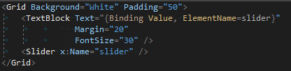
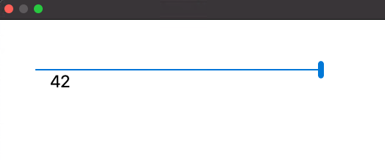
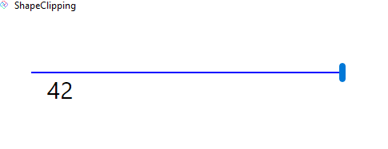
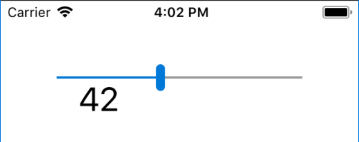
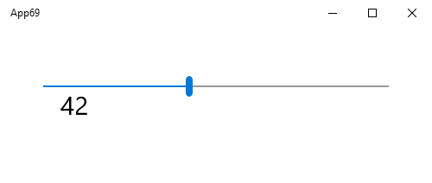
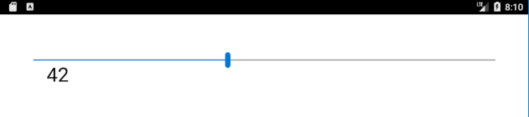
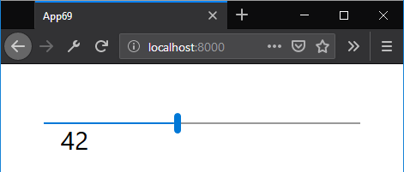
XAML
macOS
Linux
iOS
WINDOWS
ANDROID
WEBASSEMBLY

Slide 4
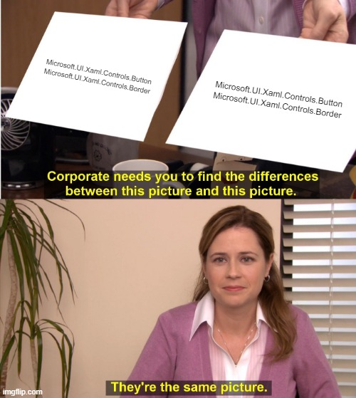

WinUI

Slide 5

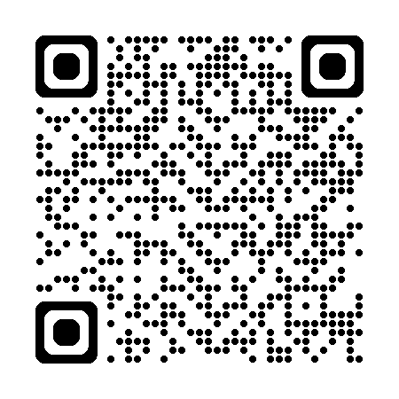
Demo
We have a wizard!
https://new.platform.uno/

Slide 6

Non-UI APIs
Accelerometer
App Actions
App Close Handler
App Suspension
Application Data and Settings
Badge Notifications
Barometer
Bluetooth
Clipboard
Contacts
Credential Storage
Device Enumeration
Device Information
E-mail
File Management
File and Folder Pickers
Flashlight
Geolocation (GPS)
Gyrometer
Haptics
Keeping Screen On
Light Sensor
Magnetometer
MIDI
Network Information
Orientation Sensor
Package Information
Personalization
Phone Calls
PowerManager
Proximity Sensor
Sharing
SMS
Settings
Speech Recognition
Step Counter
Title Bar Customization
URI Launcher
Vibration
Web Authentication Broker

Slide 7

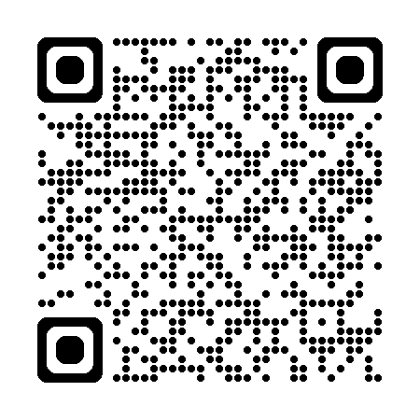
Non UI APIs https://aka.platform.uno/demo-unexpected-apis
Demo

Slide 8
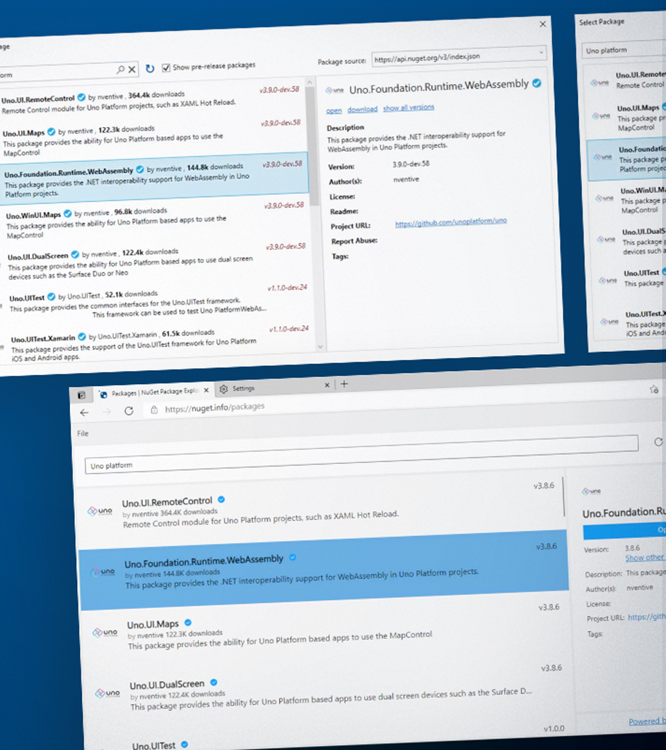

Case study
NuGet Package Explorer
Great Modernization Strategy
WinUI on the Web
30,000 Monthly Active Users
22% on non-Windows Machines
96% Web users post-deployment
NuGet.info

Slide 9
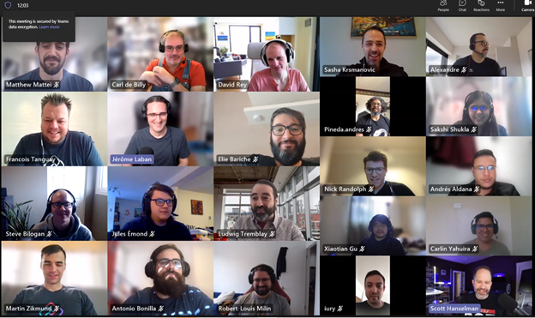




THANKS!
1
2
3
Try Uno Platform: platform.uno
Chat with us on Discord platform.uno/discord
Report issues or contribute github.com/unoplatform
https://kazo0.dev
@BiloganSteve
@kazo0

